Slide 1

Analyzing the Neighborhood Coffee Shops in Calgary
Coursera Capstone Project

Slide 2
Introduction
According to the 2018 census for the metropolitan area, Calgary has the highest concentration of head offices in Canada and is home to 115 or approximately 1 in 7 of Canada’s 800 largest corporate headquarters (Ly, 2018).
With the numerous head offices and corporate offices situated in Calgary, the number of coffee shops located in Calgary is also abundant. This report will focus on analyzing the coffee venues in Calgary city to offer an assessment of how the location and surrounding venues might affect the overall performance of the coffee shops. By exploring the neighborhood venues of the coffee shops, this report will provide insight to business owners on potentially where to open a new coffee shop in Calgary.
Ly, P. U. B. L. I. S. H. E. D. J. U. (2018). Fact Sheet : Calgary Head Offices, 1–5.

Slide 3
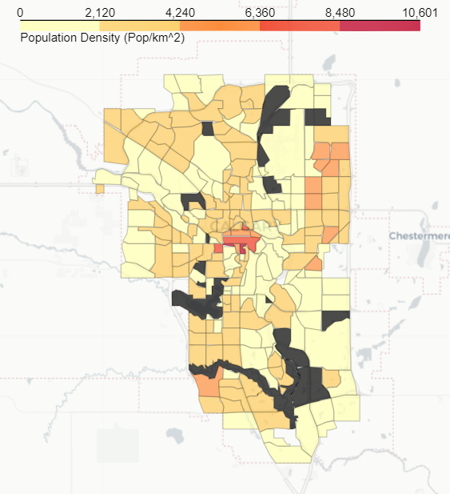
Data Sources and Preparation
Based on the problem definition, the different factors to be considered in the analysis includes:
Calgary neighborhood and demographic information
Number of different coffee shop venues in Calgary neighborhoods
The types of venues surrounding the coffee shops
Coffee shop ratings, likes, photos, tips, and price

Slide 4
Data Sources and Preparation
Data Sources:
Calgary Neighbourhood and Census Dataset
Calgary Neighborhood Geojson File
Data Preparation:
Geopy—is used to scrape the Calgary Neighbourhood and Census Dataset to generate latitude and longitude information for further analysis
Foursquare API—is used to explore the Calgary neighborhoods to generate the list of venues
Foursquare API—is also used to obtain detailed information for each venue including ratings, likes, photos, tips, and price

Slide 5
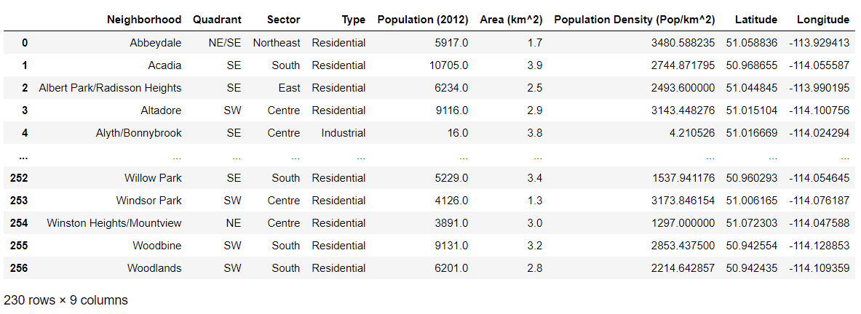
Methodology
This analysis will focus on analyzing the coffee venues in Calgary city to offer an assessment of how the location and surrounding venues might affect the overall performance of the coffee shops.
First, the Calgary Neighborhood and Census Dataset were scraped from Wikipedia webpage using pandas read_html( ) method

Slide 6
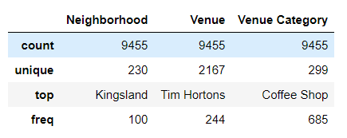
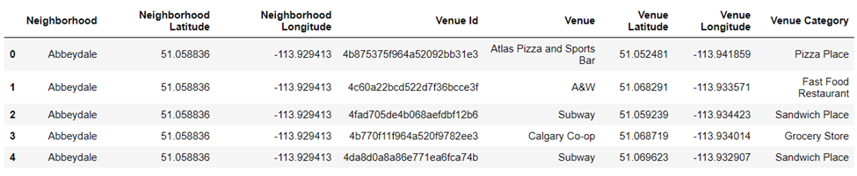
Methodology
Foursquare API was utilized to generate a list of venues using the latitude and longitude information for each neighborhood.
The parameters used for venue limit and radius were set to 100 and 1500m respectively.

Slide 7
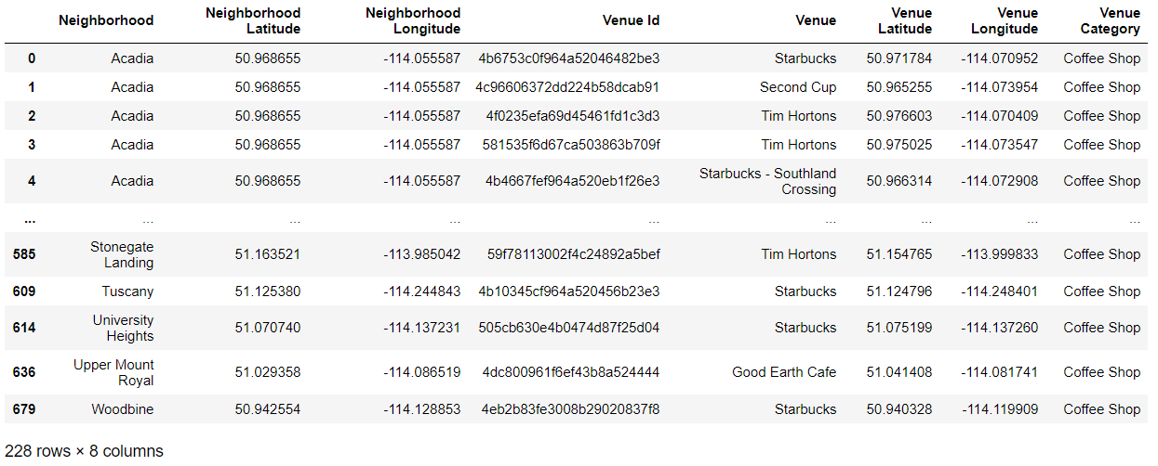
Methodology
The dataset is cleaned to generate a dataframe containing unique venues. It could be seen that there a total of 228 unique coffee shops in Calgary surrounding the neighborhoods that were explored earlier.

Slide 8
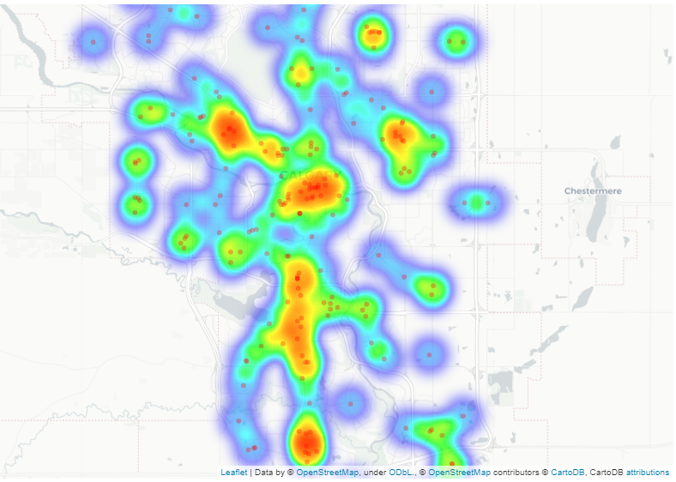
Methodology
A heatmap was also generated to provide visualization on the density and spread of the coffee shops located in Calgary. From the map generated, it could be seen that there are hotspots for coffee shops in some neighborhoods while in others the coffee shops are more sparsely situated.

Slide 9
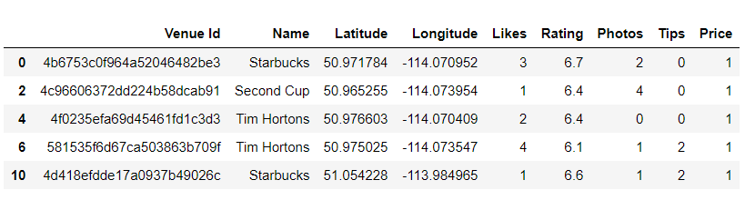
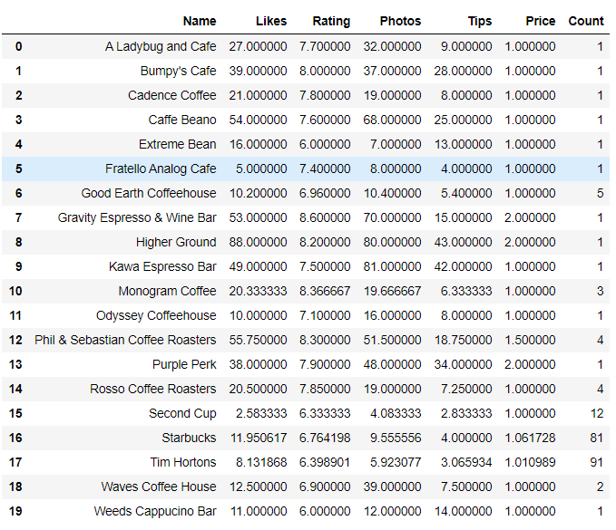
Methodology
To get a better understanding of the coffee shops generated, Foursquare API was utilized again to pull the detailed information for each coffee shop venue including ratings, likes, photos, tips as well as price.
The dataset is then grouped by coffee shop names to get summary statistics on the average parameters for each unique coffee shops.
From the data frame below it could be seen that Tim Hortons and Starbucks are the most common coffee shops in Calgary with counts of over 91 and 81 respectively.

Slide 10
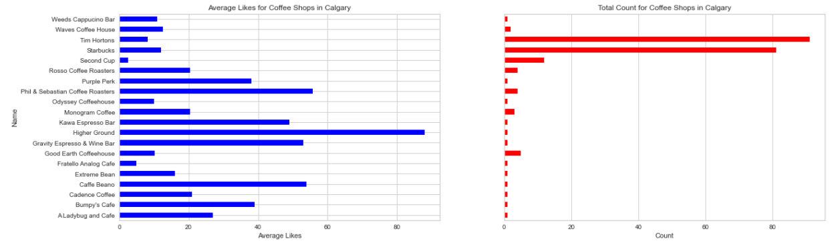
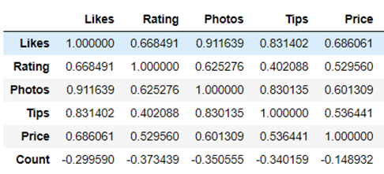
Methodology
Matplotlib was used to graph the dataset to provide better visualization. The graph below shows the average likes correlated with the total count of the coffee shops.
A correlation analysis was also conducted on the dataset to gauge how closely the different parameters correlate to each other. Ratings is a good metric to use in this scenario to gauge the average consensus amongst userbase on the popularity/likeability of each coffee shop.

Slide 11
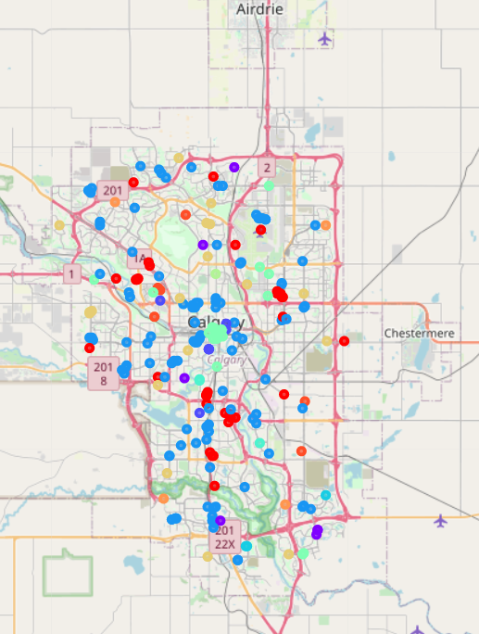
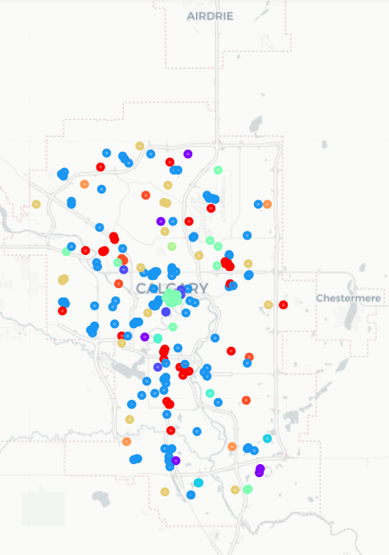
Methodology
To answer the original question: whether neighborhood venues influence the coffee shop ratings and performance. Foursquare API was utilized to pull the surrounding venues for the list of unique coffee shops generated previously.
The dataset is then formatted, and one-hot encoding was performed on the venue category. After encoding, sklearn was utilized to cluster the different coffee shops together based on their surrounding venues, k =11 was selected for this analysis. This approach was taken to group coffee shops with similar surrounding venues together. The resulting clusters are then visualized using Folium

Slide 12
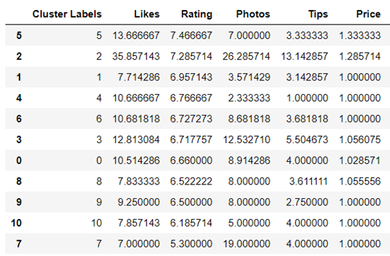
Results
After k-means clustering was employed, the dataset is grouped by individual cluster labels and sorted by ratings in descending order. It could be seen that cluster labels 5 and 2 have the highest average rating and pricing, while cluster labels 10, 7, and 9 have the lowest average rating and price points.

Slide 13
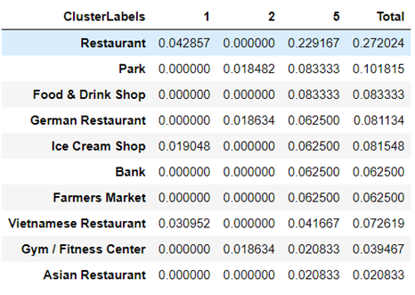
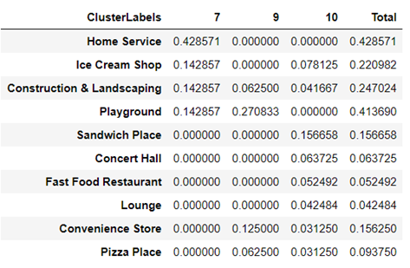
Results
To answer the question posed earlier on how the location and surrounding venues might affect the overall performance of the coffee shops. The top three clusters and bottom three clusters are further examined.

Slide 14
Results
To answer the question posed earlier on how the location and surrounding venues might affect the overall performance of the coffee shops. The top three clusters and bottom three clusters are further examined.
From the dataset, it could be seen that coffee shops with good ratings tend to be located within proximity to restaurants, parks, and other food and drink shops. These surrounding venues provide a leisure environment for customers to enjoy the coffee in, and as a result, the coffee shops tend to have a higher average rating than the rest.
On the other hand, coffee shops located near home services, construction and landscaping, playground, and convenience stores tend to have a poor rating. This could be due to the category of the surrounding venues being more utility based, and customers who visit these coffee shops are typically more rushed and thus would have less time to enjoy the coffee.

Slide 15
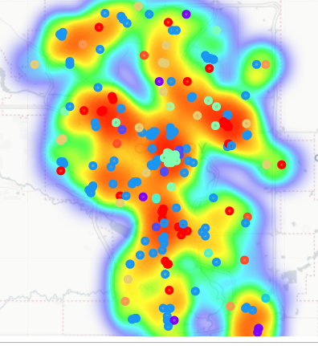
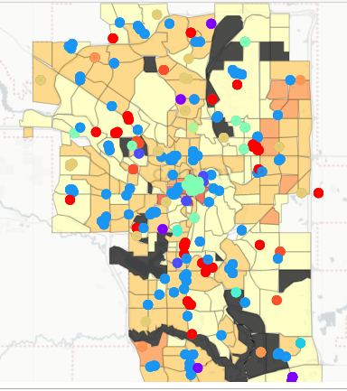
Discussion
To provide insight to business owners on potentially where to open a new coffee shop in Calgary. The neighborhood venues of the coffee shops are clustered and plotted below in a choropleth map and heat map using Folium.
Based on the population density and heat map, the optimal location to open new coffee shops is in a populated neighborhood within proximity to leisure venues such as restaurants, parks, and other food and drink shops.
From the coffee shop density heat map, a location that meets the above criteria and does not contain a large number of coffee shops can be selected.

Slide 16

Conclusion
In this report, the coffee venues in Calgary city was analyzed, clustered, and grouped into different categories based on their surrounding venues. Ratings of coffee shops are then used to select the most optimal and least optimal cluster venues. However, this report only considered a few factors that might affect coffee shop ratings. For a more robust analysis, many more aspects need to be taken into account.
For instance, one problem not addressed in this analysis is that there are many different types of coffee shops and some coffee shops could have higher ratings than others based on factors other than location/surrounding venues.
In addition, the rating data obtained from Foursquare is limited and only reflects user feedback from one platform. Rating also cannot be directly correlated to how well a coffee shop is operating and how much revenue it is generating.
This report only serves as a preliminary analysis to gain an understanding of how different surrounding venues might affect the overall coffee shop ratings.

